Slide 1

Exploratory Data Analysis
July 2025
Delante E. Moore

Slide 2


Exploratory Data Analysis
What is Exploratory Data Analysis (EDA)?
Systematic approach to summarizing and visualizing data before modeling
Helps uncover structure, spot anomalies, test assumptions
Key EDA Steps
Data cleaning & handling missing values
Descriptive statistics (mean, median, variance)
Visual inspections (histograms, box plots, scatterplots)
Why EDA First?
Prevents “garbage in, garbage out” in downstream analyses
Builds your intuition—know your data before you trust your models
Azevedo, N. (2023, July 21). Image
In What is Exploratory Data Analysis? Steps & Examples. Scalable Path.
Retrieved June 25, 2025, from https://www.scalablepath.com/data-science/exploratory-data-analysis
Notes:
Welcome to our Exploratory Data Analysis overview. Exploratory Data Analysis, or EDA, is your first line of defense against bad data. It’s a systematic process of summarizing and visualizing your dataset before you ever build a model. Think of it as a reconnaissance mission—scanning the terrain so you know what you’re up against.
First, EDA helps uncover the hidden structure in your data. We look for clusters, patterns, or gaps—anything that signals a distinct operating mode or an unexpected event. It also shines a spotlight on anomalies: for example, a single test run that lasts twice as long as every other—could be a sensor glitch or a special test scenario. And critically, EDA lets us test the assumptions most analytical methods rely on, like whether our variables approximate a normal distribution or whether relationships appear linear.
Our EDA workflow has three core steps:
Data Cleaning & Handling Missing Values “Begin by identifying any missing or placeholder entries—sometimes a ‘–1’ in a range field really means ‘data not recorded.’ Decide whether to impute those values, remove the records, or flag them for follow-up. Cleaning your data up front prevents surprises later.”
Descriptive Statistics “Next, compute key metrics: mean and median to understand central tendency, variance and standard deviation for spread. Compare the mean versus the median to gauge skew—if they differ significantly, you may have a long tail in your distribution that needs special attention.”
Visual Inspections “Finally, generate visual plots. Histograms reveal your full distribution shape—unimodal, bimodal, or more complex. Box-plots highlight quartiles and outliers in a glance. And scatterplots let you eyeball relationships between two variables, spotting correlations you’ll later quantify.”
Why do all this before modeling? Two big reasons:
Prevent “Garbage In, Garbage Out.” “Feeding raw, unvetted data into machine-learning pipelines or statistical tests guarantees misleading results. A small investment in EDA saves hours of wasted effort chasing phantom patterns.”
Build Your Intuition “When you’ve explored every nook of your dataset, you’ll recognize when a model’s output doesn’t make sense. That subject-matter insight is vital in defense studies—your analyses must be defensible, transparent, and trusted.”

Slide 3
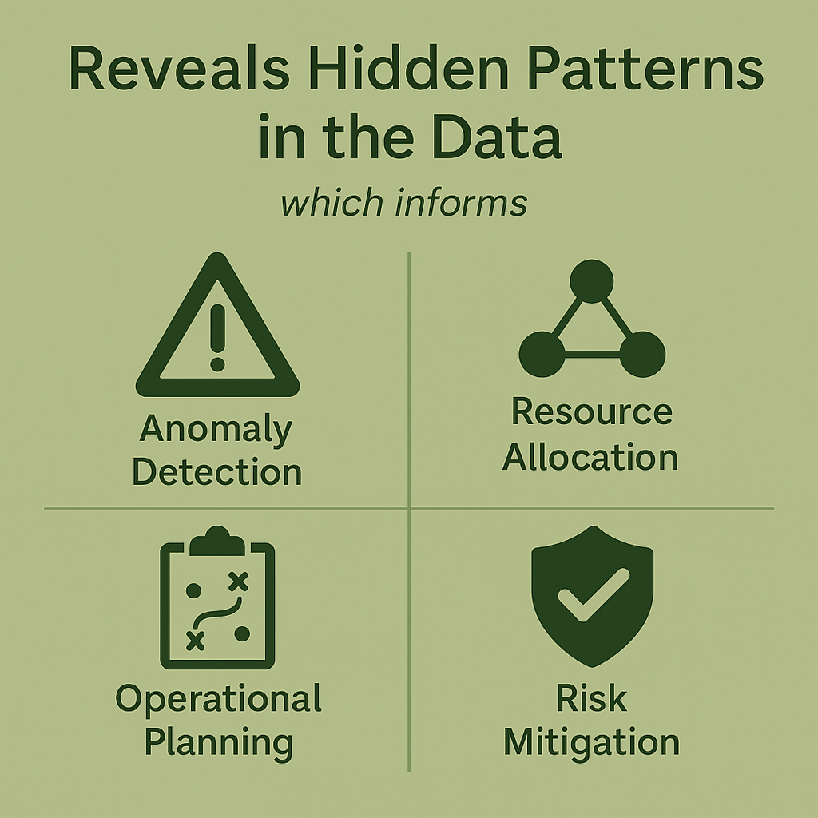
Motivation – Why does EDA even Matter?
Notes:
Now that we’ve defined EDA, let’s talk about why it matters in a defense context. There are five key reasons to make exploratory analysis your first step.
Reveal Hidden Patterns “Imagine you’re monitoring sensor feeds across a forward operating base. A sudden spike in vibration readings on one sensor—or an unexpected shift in unit movement patterns—could signal an emerging threat or equipment failure. EDA brings these anomalies to light before they become critical.”
Optimize Resource Allocation “Defense operations run on scarce assets: surveillance drones, satellite passes, logistics convoys. By summarizing usage and stress levels—say, which radar installations handle the most traffic or which supply routes see repeated delays—you can direct maintenance crews or reroute shipments where they’re needed most.”
Enhance Operational Planning “Every mission has timing constraints: sortie lengths, convoy transit times, patrol durations. Plotting the distribution of those durations shows you whether most operations finish on schedule—or if a long tail of overruns is eating into readiness. With that insight, planners can build more realistic schedules and buffer time for critical tasks.”
Inform Intelligence & Decision-Making “No data is perfect. EDA quantifies the gaps in your dataset—missing GPS logs, undefined unit classifications, gaps in SIGINT collection. When you know ‘where the holes are,’ you can prioritize reconnaissance, task additional sensors, or adjust your collection plan to fill those intelligence blind spots.”
Support Risk Mitigation “Finally, summarizing key metrics and flagging outliers helps you identify systemic vulnerabilities. For instance, if certain deployment scenarios repeatedly show high failure rates or abnormal readings, you can investigate root causes and adjust tactics, technical protocols, or training—reducing risk through data-driven policy changes.”
“Together, these motivations show that EDA isn’t an optional luxury—it’s a force multiplier. It empowers you to spot trouble early, deploy assets more effectively, plan realistic operations, close intelligence gaps, and shape policies that keep forces safer and more effective.

Slide 4

Data Cleaning and Preparation
Key Steps:
Identify & Quantify Missing Data
Handle Missing Values
Imputation
Removal:
Flagging:
Validate & Correct Data Types
Detect & Treat Outliers
Standardize & Normalize
Document Transformations
Notes:
In this segment, we’re diving into Data Cleaning & Preparation, the foundational step that ensures your analyses rest on solid ground.
First, we identify and quantify missing data. Scan every column for nulls or placeholder codes like –1 or 0 that really mean ‘value not recorded.’ Calculate the missingness rate—for example, if 15 % of your range measurements are missing, you know you have a significant data-collection gap to address.
Next, we handle those missing values. You have three main options:
Impute with statistical summaries—mean, median—or, better yet, domain‐informed estimates (e.g., using similar weapon‐system runs).
Remove any records or even entire variables if they’re more empty than full.
Or flag the missing entries so that downstream models can treat them differently.
Third, we validate and correct data types. Check that numeric readings aren’t accidentally imported as text, and convert date or timestamp fields into a consistent format. A misparsed date can completely derail a time‐series analysis.
Fourth, we detect and treat outliers. Use interquartile-range or Z-score methods to flag extreme test‐duration or failure‐count values. Decide whether to cap them, remove them, or investigate further—sometimes an outlier points to a genuine system fault you need to understand.
Fifth, we standardize and normalize features. Scaling variables—whether via min–max or standard z-scores—ensures that differences in units don’t skew distance-based methods later on. When interpretability matters, retain original units alongside scaled versions.
Finally, document every transformation. Keep a clear changelog and metadata file that records what you did, when, and why. This audit trail not only helps collaborators reproduce your work, it also builds trust in your findings—vital in any defense analysis.
That’s our cleaning checklist. On the next slide, we’ll jump into a live demo—using either Excel or R—so you can see these steps in action on our sample dataset

Slide 5
Data Cleaning and Preparation (Example)
Test ID | Test Duration (mins) | Failure Count
A001 | 45 | 1
A002 |  | 2
A003 | 30 | 0
A004 | 55 | 1
Notes:
Let’s walk through cleaning and preparing our sample test dataset. Here’s what we’re working with:
Identify Missing Values
Notice that A002 has no duration recorded. In Excel, you’d select the TestDuration column, use Go To Special → Blanks to highlight it. In R, you’d run
colSums(is.na(df$TestDuration))
Impute with Median
To fill A002’s gap, we compute the median of the three known durations: 45, 30, and 55—that’s 45 minutes.
=IF( ISBLANK(B2),
MEDIAN( $B$2:$B$100 ),
B2)
In R, you would run the following:
med <- median(df$TestDuration, na.rm=TRUE)
df$TestDuration[is.na(df$TestDuration)] <- med
After this, A002 reads 45.
Validate Data Types
In Excel, make sure TestDuration is formatted as Number, not Text. In R, check with str(df)
Detect and Treat Outliers
Next, we flag any extreme durations. Calculate the mean and standard deviation:
Durations now: 45, 45, 30, 55
Mean ≈ 43.75, SD ≈ 10.31
A simple Z-score threshold is |z|>3:
Excel Z-score formula in C2:
=AVERAGE( $B$2:$B$100 )
=STDEV.P( $B$2:$B$100 )
=ABS( (B2 – $D$2) / $D$3 ) > 3
where D2 is the mean, D3 the SD. No value exceeds 3, so we keep all rows.
In R
df$z <- (df$TestDuration - mean(df$TestDuration)) /
sd(df$TestDuration)
df_clean <- subset(df, abs(z) <= 3)
Our cleaned dataset still has all four runs.
Document Your Steps
Finally, record each change:
A002 imputed to 45 min
No outliers removed
Data types confirmed numeric
Keeping this log ensures reproducibility—critical for defense analyses.
“With our data cleaned, typed correctly, and free of extreme anomalies, we’re now ready to move on to summary statistics and deeper EDA. Let’s continue!”

Slide 6
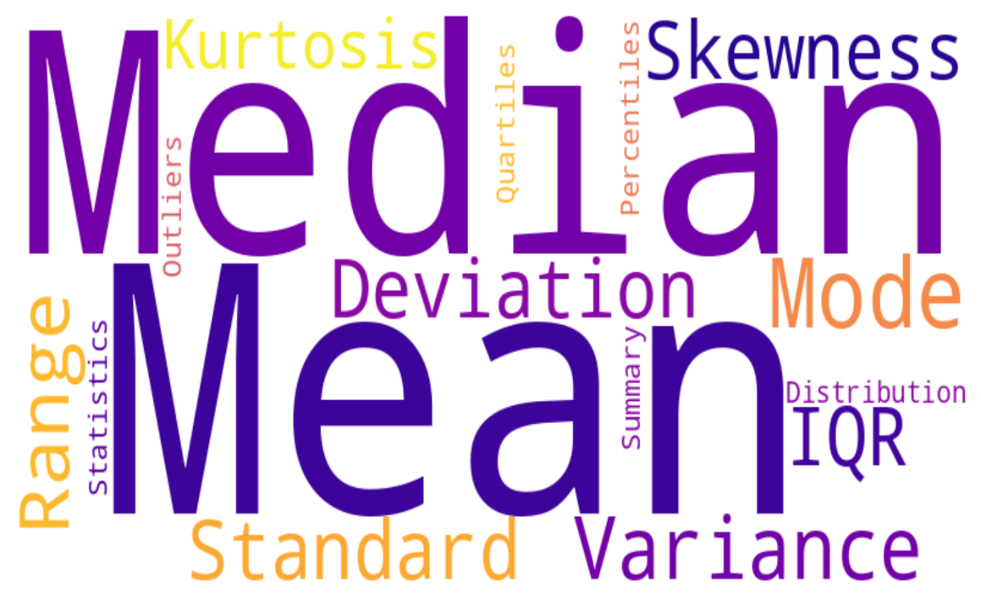
Summary Statistics
Key Steps:
Why They Matter
Offer a quick, quantitative snapshot of your data
Reveal central tendency, variability, and distribution shape
Help detect anomalies before deeper analysis
Key Metrics
Central Tendency
Mean: arithmetic average
Median: middle value (robust to outliers)
Mode: most frequent value
Dispersion
Range: max – min
Variance & Std Dev: average squared deviation; spread
Interquartile Range (IQR): Q3 – Q1, focuses on middle 50%
Shape
Skewness: asymmetry of distribution
Kurtosis: “tailedness” relative to normal
Notes:
Now that we have a cleaned and properly formatted dataset, we can now generate some Summary Statistics. These metrics give you a quick, quantitative snapshot of your data, revealing its center, spread, and overall shape before you dive deeper.
First up, Central Tendency.
The mean is the arithmetic average—think of it as the ‘typical’ test-run duration.
The median is the middle value, which guards against skew from a few extreme tests.
And the mode tells you the most frequently occurring outcome—useful when discrete events repeat, such as failure counts.
Next, Dispersion.
The range (max minus min) shows your full spread—say, from the shortest patrol to the longest.
Variance and standard deviation quantify how tightly your data cluster around the mean. A high standard deviation in sortie times, for instance, flags inconsistent mission lengths.
The interquartile range, or IQR, hones in on the middle 50% of values—helpful when you want to ignore extreme outliers.
Finally, the Shape of your distribution.
Skewness measures asymmetry—does your data lean toward unusually long test runs?
Kurtosis assesses ‘tailedness,’ telling you whether extreme events occur more often than a normal curve predicts.
Together, these summary statistics help you detect anomalies, understand variability, and inform planning in defense operations. On our next slide, we’ll jump into a live demo in both R and Excel so you can see these numbers computed and interpreted

Slide 7
Summary Statistics
Key Steps:
Statistic | R Code | Excel Formula | Example (TestDuration)
Mean | mean(df$TestDuration) | =AVERAGE(B2:B5) | 43.75
Median | median(df$TestDuration) | =MEDIAN(B2:B5) | 45
Std Deviation | sd(df$TestDuration) | =STDEV.P(B2:B5) | ≈ 10.31
Min / Max | min(df$TestDuration) / max(df$TestDuration) | =MIN(B2:B5) / =MAX(B2:B5) | 30 / 55
IQR | IQR(df$TestDuration) | *(Calc: Q3–Q1 via QUARTILE) | 12.5
Notes:
Mean ≈ 43.8 min: average test run length
Median = 45 min: distribution is slightly left-skewed
Std Dev ≈ 10.3 min: moderate variability
IQR = 12.5 min: middle 50% of tests span 12.5 minutes

Slide 8

Visualizations
Key Steps:
Histogram
Shows distribution of a single variable (e.g., test durations)
Highlights skewness, multimodality, and gaps
Box Plot
Summarizes median, quartiles, and outliers
Compares spread across groups (e.g., by system type)
Scatter Plot
Reveals relationships between two continuous variables
Heatmap / Correlation Matrix
Displays pairwise correlations among variables
Guides feature selection and multicollinearity checks
Notes:
On this slide, we introduce four fundamental chart types in exploratory analysis:
Histograms let us visualize the full distribution of a variable—spotting skew or multiple peaks.
Box Plots condense key percentiles and make outliers immediately visible, and when grouped, they let you compare distributions side by side.
Scatter Plots uncover relationships or trends between two metrics, for instance whether high temperatures correlate with more failures.
Heatmaps or Correlation Matrices show all pairwise correlations, helping us identify which variables move together and which might be redundant for modeling.
Each of these visual tools provides different lenses on your data, ensuring you uncover patterns before you proceed with more advanced analyses.

Slide 9
Visualizations
Key Steps:
Chart Type | R Code | Excel Steps
Histogram | hist(df$TestDurationMin, main="Duration Distribution", xlab="Min") | Insert → Chart → Histogram; set Data Range to column
Box Plot | boxplot(TestDurationMin ~ SystemType, data=df, main="By System") | Select SystemType & TestDuration Columns Insert → Box & Whisker
Scatter Plot | plot(df$EnvTempC, df$FailureCount, xlab="Temp (C)", ylab="Failures") | Insert → Chart → Scatter; select two columns
Correlation Heatmap | cor_mat <- cor(df[,c(3:7)]); heatmap(cor_mat) | Compute CORREL() matrix, then Insert → Heatmap-style conditional formatting
Notes:
Let’s jump into a live demo using our CSV:
Histogram:
R: hist(df$TestDurationMin, main="Duration Distribution", xlab="Minutes") We see most tests cluster around 30–45 minutes, with a tail extending longer.
Excel: Use the Histogram chart wizard on the TestDurationMin column.
Box Plot by System:
R: boxplot(TestDurationMin ~ SystemType, data=df, main="Duration by System") Notice that Missile tests tend to have longer durations than drones.
Excel: Select SystemType and TestDurationMin columns, then insert a Box & Whisker chart.
Scatter Plot (EnvTemp vs. Failures):
R: plot(df$EnvTempC, df$FailureCount, xlab="Environment Temp (C)", ylab="Failure Count") We can eyeball whether hotter conditions lead to more failures.
Excel: Insert a Scatter chart using EnvTempC on X and FailureCount on Y.
Correlation Heatmap:
R:
cor_mat <- cor(df[, c("TestDurationMin","FailureCount","AccuracyPct","EnvTempC","OperatorExpYears")]) heatmap(cor_mat, main="Correlation Matrix")
Excel: Build a grid computing =CORREL() for each variable pair, then apply conditional formatting with a diverging color scale.
As you see, visualizations in both R and Excel quickly convey insights—distribution shapes, group differences, relationships, and overall variable interdependencies. These are invaluable for guiding your next analysis steps

Slide 10

Correlation Analysis
Key Steps:
What It Is:
Measures strength & direction of linear (Pearson) or monotonic (Spearman) relationships
Values range from –1 (perfect negative) to +1 (perfect positive), 0 means no association
Why It Matters:
Identifies which variables move together
(e.g., higher temperatures → more failures)
Flags multicollinearity risks before modeling
Guides feature selection and engineering
Common Tools:
Correlation Matrix (table of pairwise coefficients)
Heatmap (visual color‐coded matrix)
Scatterplot Matrix (pairwise scatter grids)
Notes:
Here we introduce Correlation Analysis, which quantifies how two variables relate.
• We most often use Pearson’s r for linear associations—values near ±1 signal a very strong relationship. When distributions aren’t normal or relationships are monotonic but non-linear, we switch to Spearman’s rho.
• In defense studies, correlation helps us see, for example, whether environment temperature reliably predicts failure count, or if operator experience associates with test duration.
• A correlation matrix lays out every pairwise coefficient; a heatmap turns that into an intuitive color grid; and a scatterplot matrix shows each relationship in its own subplot.
Understanding these associations early prevents you from feeding highly correlated features into the same model—avoiding redundancy and unstable estimates.

Slide 11
Wrap Up
Key Steps:
Key Takeaways:
Data Cleaning & Preparation – tackle missing values, correct types, flag outliers, and scale features
Summary Statistics – use mean, median, IQR, and standard deviation to understand central tendency and spread
Visualizations – histograms, box plots, scatter plots, and heatmaps reveal distribution shapes and relationships
Correlation Analysis – quantify feature associations and guard against multicollinearity
Next Steps:
Feature Engineering – create new variables based on domain insights (e.g., normalized failure rates)
Model Building – apply classification or regression techniques with cross-validation
Validation & Interpretation – assess model performance using defense-relevant metrics (precision, recall, ROC AUC)
Reporting & Documentation – compile findings into clear briefs and maintain reproducible code notebooks
Notes:
Alright, let’s wrap up this quick lesson on Exploratory Data Analysis and look ahead to what comes next.
First, our Key Takeaways:
Data Cleaning & Preparation: We tackled missing values, enforced correct data types, flagged outliers, and scaled features, which lays the groundwork for reliable analysis.
Summary Statistics: We used mean, median, IQR, and standard deviation to get a clear picture of central tendencies and variability in our test data.
Visualizations: Through histograms, box plots, scatter plots, and heatmaps, we revealed distribution shapes, compared groups, and uncovered relationships at a glance.
Correlation Analysis: We quantified how variables like temperature, failure count, and operator experience move together as well as flagged any multicollinearity risks before modeling.
With those insights in hand, here are our Next Steps:
Feature Engineering: Leverage domain knowledge—create new variables such as failure-rate per hour or temperature-adjusted accuracy to enrich your models.
Model Building: Move into supervised learning: try classification or regression algorithms with cross-validation to predict outcomes like test success or failure likelihood.
Validation & Interpretation: Evaluate performance using defense-relevant metrics—precision and recall to balance false alarms vs. missed failures, and ROC AUC for overall discrimination ability.
Reporting & Documentation: Compile your findings into concise briefs or dashboards, and keep your code and transformation logs well-organized so colleagues can reproduce and trust your analysis.
That concludes our EDA deep dive. You now have a solid process—from raw data to actionable insights—that will power robust decision-making in any defense studies context. Thanks for watching, and I look forward to seeing how you apply these techniques to your own data!

